Slide 1
Data Structure Semester III Course

Slide 2
Course Outcomes
Course Outcome | After successful completion of the course students should be able to
CO1 | Explain the different data structures used in problem solving
CO2 | Apply linear and non-linear data structure in application development.
CO3 | Describe concepts of advance data structures like set, map & dictionary
CO4 | Demonstrate sorting and searching methods.

Slide 3
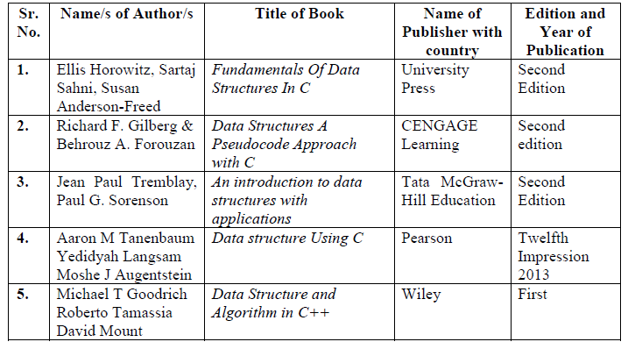
List Books
Recommended Books:

Slide 4
Modes of Content Delivery
Blackboard Teaching
Visual Aids
Seminar
NPTEL Video Lectures
Quiz
Guest Lecture
Test

Slide 5
Practical Assessment Rubric
Criteria | Excellent (AA) | Good (AB) | Average (BB) | Poor(BC)
 | 5/10 | 4/8 | 3/6 | 2/4
Timely Execution (05) | The activity was shown on same day as suggested by Laboratory Faculty. | The activity was shown after one week of the lab. | The activity was shown after 2 weeks of the lab | The activity was shown after more than 2 weeks of the lab.
Timely Writeup Submission (10) | The Writeup was submitted in the next lab session. Post lab questions answered perfectly No Plagiarism. | The Writeup was submitted after two turns of the lab session. Post lab questions fairly answered No Plagiarism. | The Writeup was submitted after three turns of the lab session. Post lab questions poorly answered No Plagiarism. | The Writeup was submitted after a month lab session. Post lab questions are not answered No Plagiarism.
Individual Performance (10) | All the features / functionalities implemented / demonstrated. | All the features / functionalities implemented / demonstrated but not in detail | Partial coverage of the features / functionalities implemented / demonstrated. | Implementation not up to the mark / negligible performance.

Slide 6
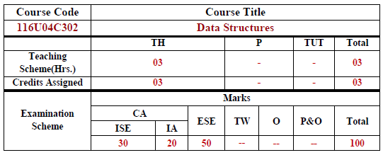
Evaluation Scheme
Number of credits – 04 (TH – 03 , PR – 01)
Term Test/ISE – 30 marks
Internal Assessment – 20 marks
End Sem. Exam – 100 converted to 50 marks

Slide 7
Test Syllabus(Expected)
Test/ISE
Introduction to Data Structures(Module 1)
Linear data structure(Module 2)
Non-Linear data structures: Trees, Graph(Module 3.1)
ESE
Entire Syllabus

Slide 8
Internal Assessment
Internal Assessment (IA) – 20 Marks
Distribution of 20 Marks | The student will be evaluated based on two tasks of 20 marks each which will be averaged later for all IA tasks. If any of the tasks given is not completed / submitted then the marks assigned for that task will be zero.
Sr. No. | Task | Description of task | Schedule | Weightage
1 | One Quiz (No re-exam will be conducted.) | Module 1,2,3 | After Test | 50%
2 | Peer grading Programming assignment using a data structure to develop solution for a small application | This can be done in a group of 2-3 students. Small applications will be assigned to each group. The presentation screencast video should- explain the problem statement, logic, code and output. The video duration will be max 10mins All students must participate in presentation Students would choose a problem statement and suggest one of the data structure for developing the solution, and how the solution will be implemented. Upon teacher’s approval, students would work on the chosen problem and submit their work. | Mid November | 50%

Slide 9
Lets Begin..

